Slide 1
Take-home data analysis Business Insight extraction from the WildChat dataset
Larry Jin
Feb, 2026

Slide 2
Research Roadmap
Dataset overview
Intent categorization and analysis
Business vertical and market potential study
User engagement study across categories and verticals
Learnings and next steps

Slide 3
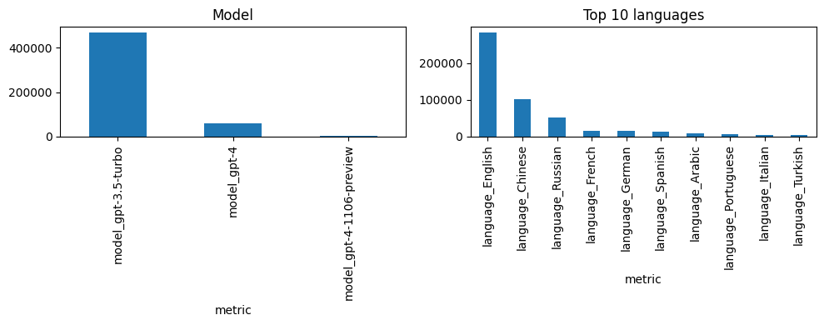
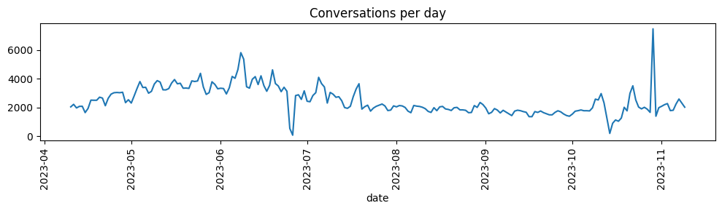
WildChat dataset overview
WildChat is a large-scale, real-world conversation dataset released by AllenAI that captures authentic user–AI interactions across languages, intents, and tasks, enabling empirical analysis of usage patterns, behavior, and model performance in the wild.
Scale & Representativeness
Average conversations per day: 2,486
Estimated total ChatGPT conversations in 2023: ~10M–100M/day
Dataset coverage of global usage: ~0.002%–0.025% (≈ 0.01% avg)
Therefore, any dollar value estimated from this dataset should be scaled by ~10,000× to approximate total market opportunity.
If focusing only on English conversations (54% of data), scaling increases to ~20,000×.
Next step: analysis will focus on English conversations for consistency and interpretability.
English conversation 54%
Average 2,486 per day

Slide 4
Intent categorization and analysis

Slide 5
Understand User Intent Behind AI Conversations
User prompts can be categorized using a standard search-intent framework adapted from SEO and information-retrieval research. This classification helps us understand why users interact with AI, whether they’re seeking knowledge, navigation, evaluation, or action, which is critical for product, monetization, and UX analysis.
Category | Definition
Informational | The user wants to learn something, get help, or have the AI generate or fix content (explanations, writing, coding, troubleshooting, etc.).
Navigational | The user is trying to find a specific site, app, organization, or resource.
Commercial investigation | The user is researching or comparing options before making a purchase decision.
Transactional | The user intends to complete a real-world action such as buying, booking, subscribing, or requesting a service.
Commercial investigation and transactional queries typically signal stronger purchase intent and therefore represent higher monetization potential for brands than informational conversations. In the following sections, we’ll dive deeper into these high-value intents and quantify their business impact.

Slide 6
Detailed Intent Distribution of English Conversations
After classifying conversations into high-level intent categories, we further segment the dataset into subcategories to understand how users actually use AI. The percentages shown are calculated from a base of approximately 280K English conversations, which provides the foundation for this distribution analysis.
Category | Subcategory | Conversations | % of Dataset | Definition
Informational | Creative Writing | 130,455 | 46.6% | Generating stories, scripts, dialogue, or imaginative text.
Informational | Casual / Other | 54,774 | 19.6% | General questions, light chat, or uncategorized requests.
Informational | Education | 50,217 | 17.9% | Learning concepts, explanations, or study help.
Informational | Coding | 23,774 | 8.5% | Writing, debugging, or understanding code or technical systems.
Informational | Support | 15,260 | 5.5% | Troubleshooting problems or fixing issues.
Commercial Investigation | Product Research | 4,112 | 1.5% | Comparing or evaluating products before purchase.
Navigational | Navigational | 3,693 | 1.3% | Finding a specific site, app, or resource.
Transactional | Transactional | 1,006 | 0.4% | Completing an action like buying, booking, or registering.
Key Insights
Creative writing is the single largest use case (130K+), showing strong demand for generative content.
Technical + learning intents (coding, education, support) together account for a major share, reinforcing AI’s role as a productivity and knowledge tool.
Commercial and transactional queries are rare (<2%), indicating monetizable intent is a small but high-value segment.

Slide 7
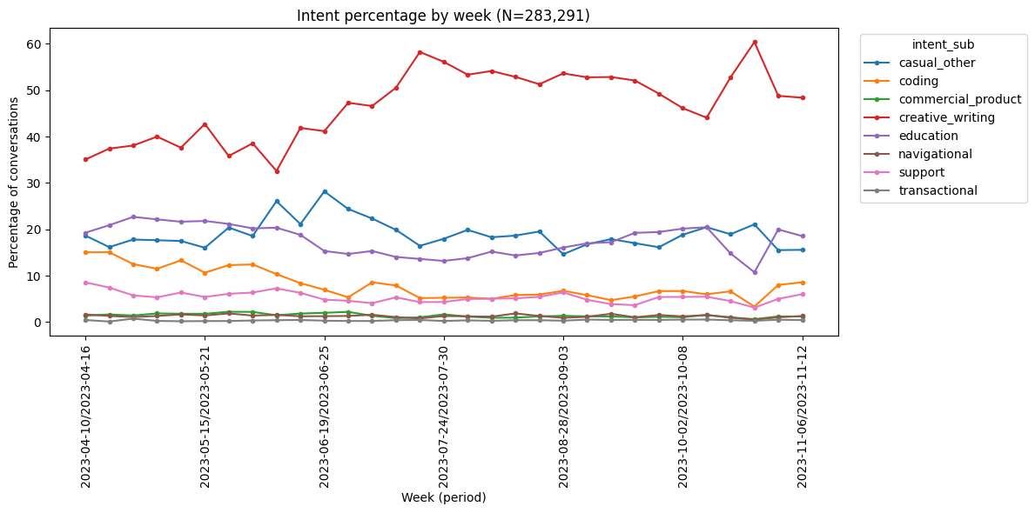
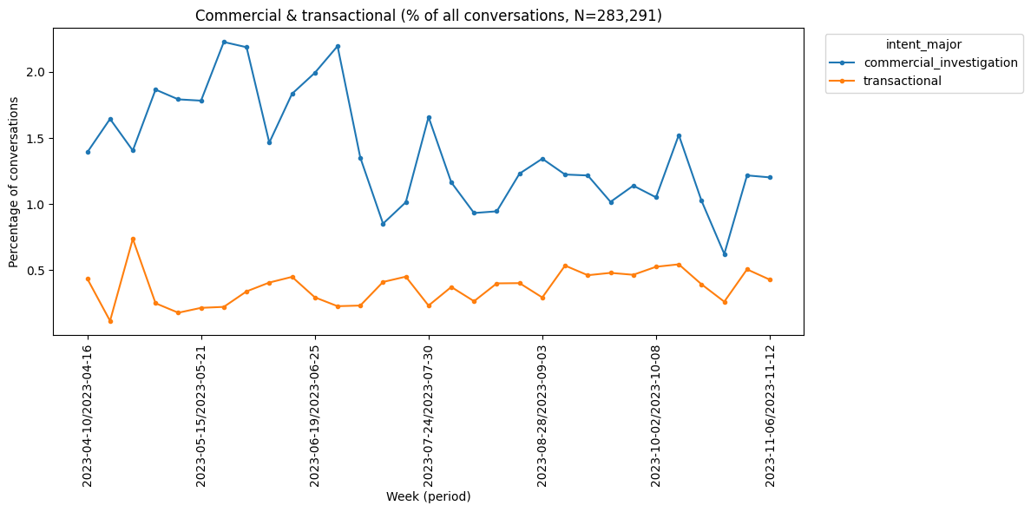
High-Intent Queries Drive Disproportionate Brand Engagement
Commercial and transactional queries make up only ~2% of conversations but carry disproportionately high business value, as they reflect users closer to conversion and actively evaluating decisions that can drive purchases or sign-ups. In the following analysis, we compare commercial, transactional, and informational (education) intents to quantify these differences.
Commercial investigation (55.7%) and transactional (51.0%) conversations show the highest brand mention rates*, indicating strong brand relevance when users are closer to decision-making.
By comparison, informational conversations (education subset: 22.7%, computed based on a sampled 5000 conversations) mention brands far less often, suggesting earlier-stage or exploratory user intent.
*Brand mention rate: defined as the percentage of conversations where a brand name, entity name or similar is mentioned.

Slide 8
Business vertical study

Slide 9
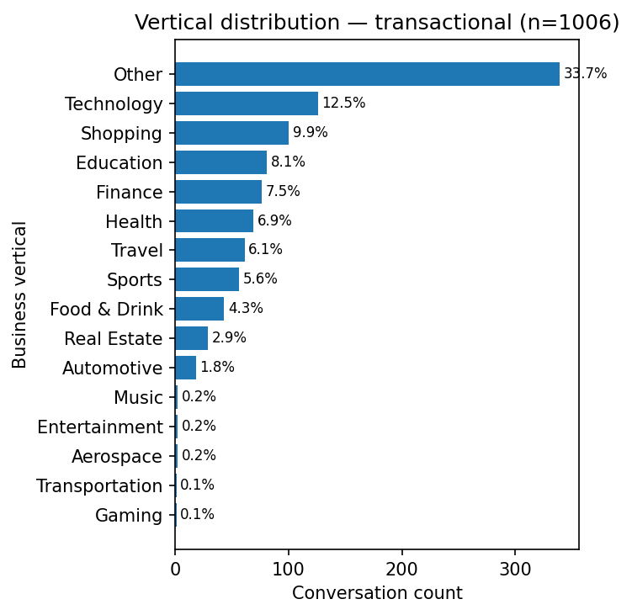
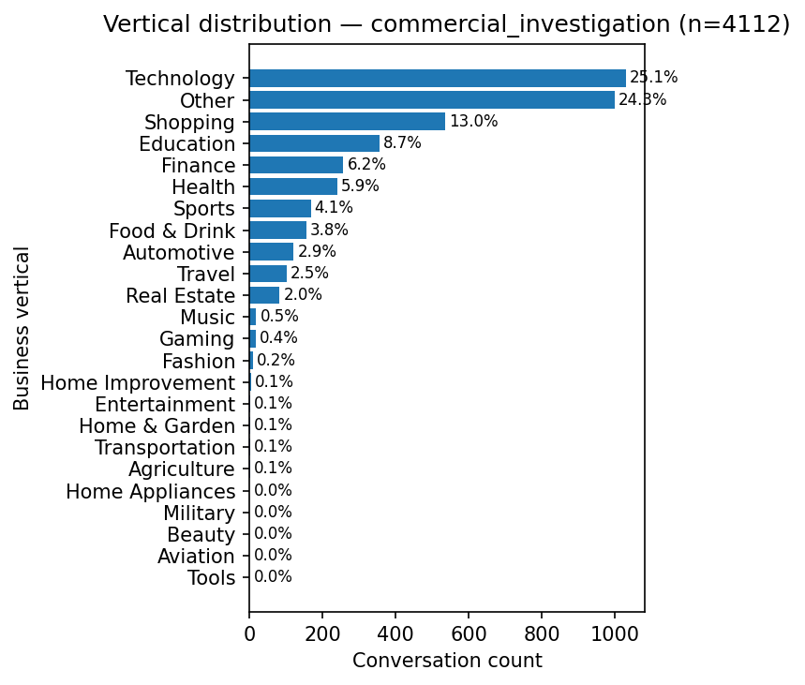
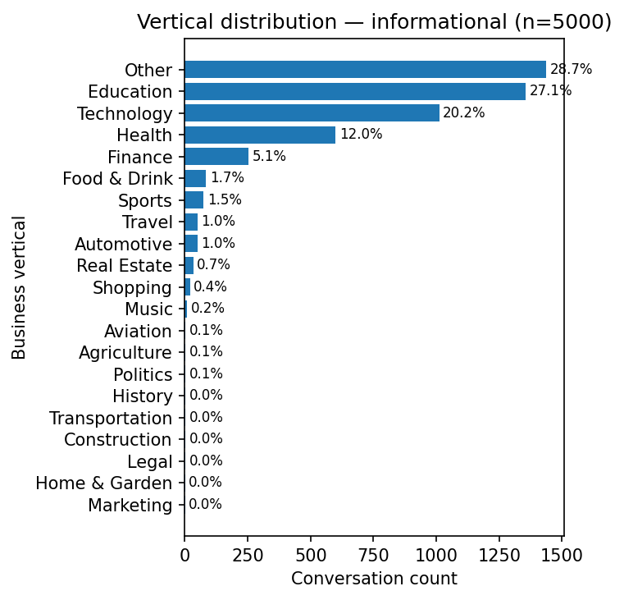
Industry Vertical Distribution Across Intent Types
Technology consistently ranks among the top verticals across all intent types, reinforcing it as the most active domain for both research and action-oriented queries.
Commercial investigation queries are concentrated in product-driven verticals such as technology and shopping, aligning with earlier findings that these intents reflect users evaluating purchase decisions.
Transactional queries show a broader vertical spread (finance, health, travel, education), suggesting real-world action intent spans multiple industries rather than being confined to retail.
Informational (education-focused) conversations skew toward knowledge-heavy domains like education, technology, and health, confirming that most AI usage today is still learning- and problem-solving–oriented.
Compared with volume-dominant informational traffic, high-intent categories reveal clearer industry signals, making them more actionable for business and monetization analysis.
Transactional category
Commercial category
Education sub-category

Slide 10
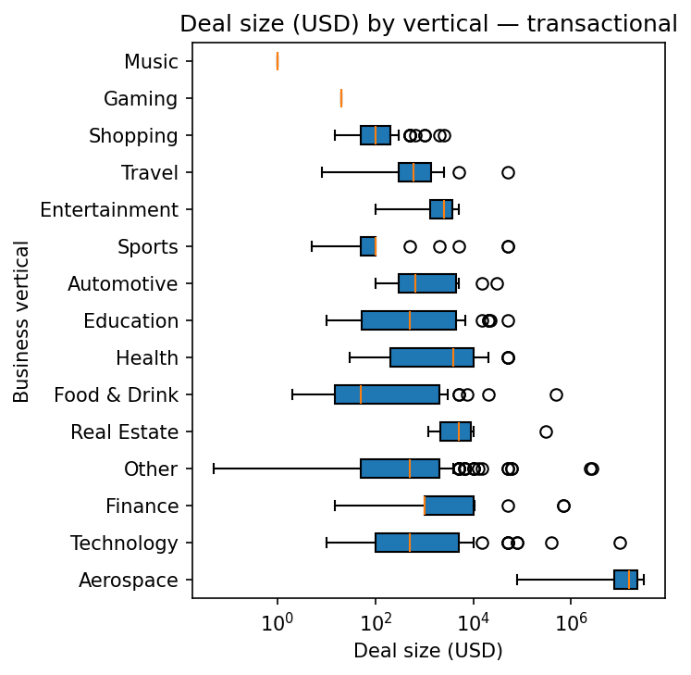
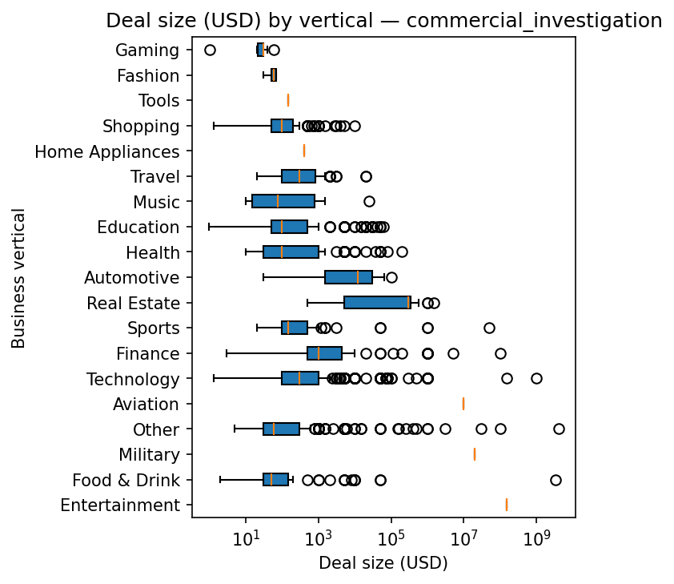
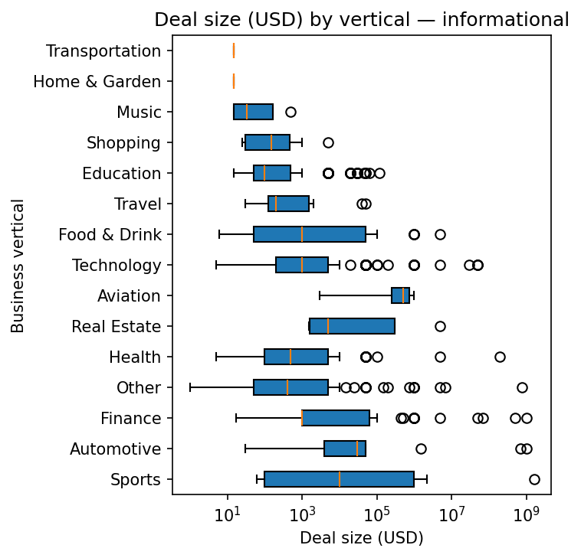
Estimated Deal Value by Industry Vertical Across Intent Types
Higher intent → higher value: Commercial and transactional queries generally show larger deal sizes than informational, reinforcing that intent quality drives economic potential.
Top monetizable verticals: Technology, Finance, Real Estate, and Automotive consistently exhibit higher typical values and strong outliers. Considering the query volume, Technology is clearly the winner.
Funnel signal: Informational queries skew lower-value because they reflect early-stage research, not low-value users.
Transactional category
Commercial category
Education sub-category
Deal values are LLM-estimated based on brands, entities, and products mentioned in conversations. Values are directional rather than exact; some outliers (e.g., aerospace or aviation) may reflect product mentions rather than true purchase intent. Despite noise, the distributions still provide meaningful comparative signals across major consumer and commercial verticals.

Slide 11
User engagement study

Slide 12
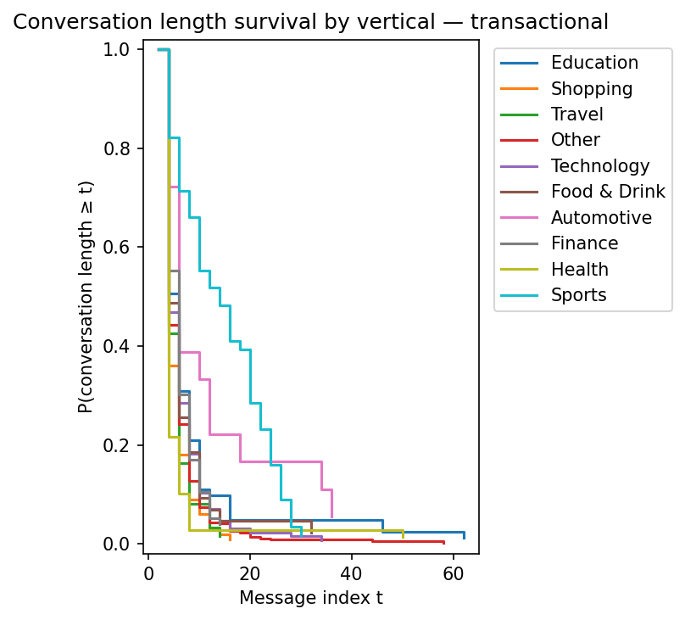
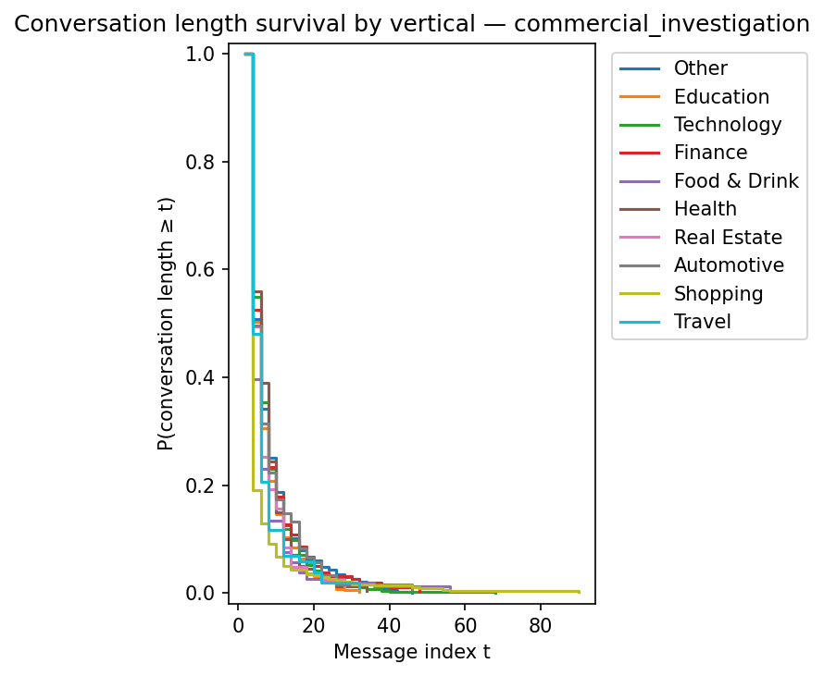
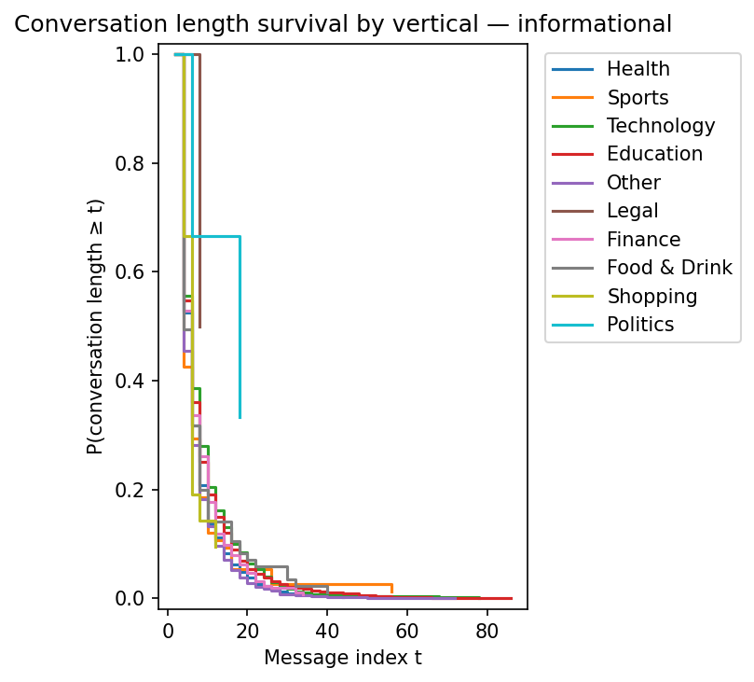
Conversation Survival Curves by Vertical: Engagement Depth Across Intents
High-engagement niches may represent high-value specialization opportunities, not just large-volume markets.
Transactional conversations sustain longer tails than informational or commercial, indicating higher engagement when users are action-oriented.
Within transactional: Sports and Automotive show especially strong retention, with curves that decay noticeably slower.
However, these segments have mid–low query volume, meaning engagement quality is high despite smaller traffic share.
Further analysis is needed to understand why Automotive and Sports users engage longer (e.g., complexity, decision cost, comparison behavior).
Transactional category
Commercial category
Education sub-category

Slide 13
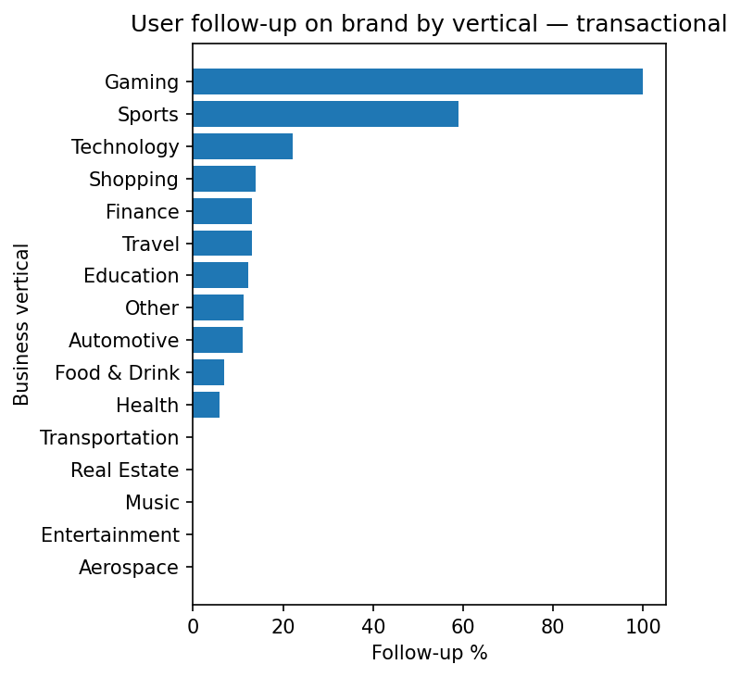
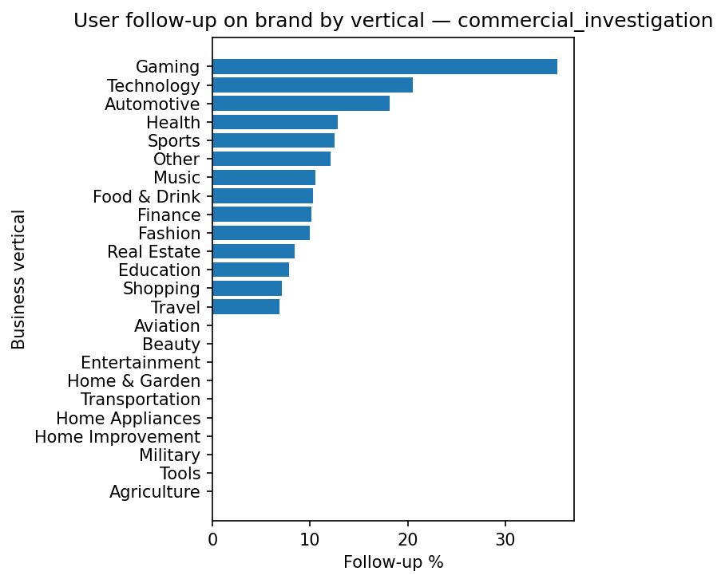
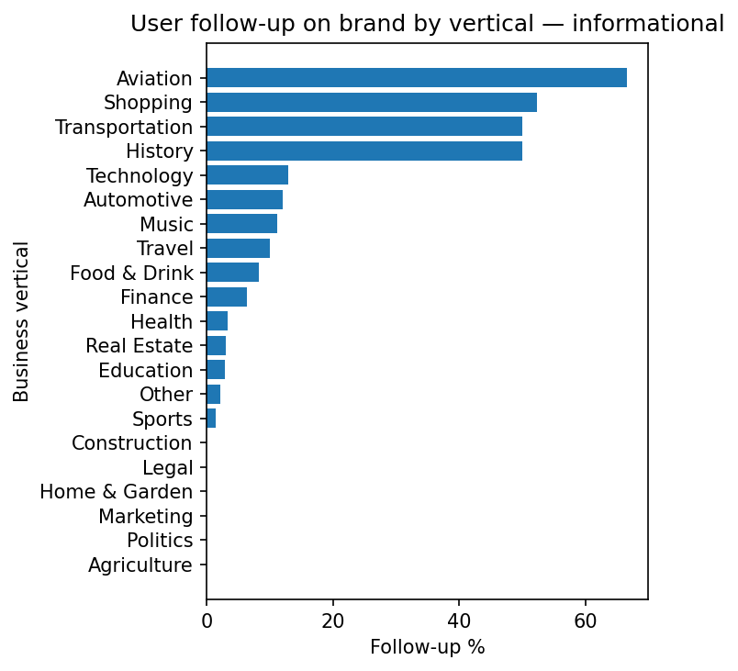
Brand Follow-Up Behavior by Vertical and Intent
A conversation counts as a brand follow-up if the assistant mentions a brand and the user references that same brand in their next message, indicating active engagement or interest. This metric captures brand responsiveness, not just brand exposure.
Technology and Shopping dominate follow-up volume across commercial and transactional intents, suggesting strong real-world product consideration.
Transactional distribution is more balanced across verticals, indicating brand-driven engagement spans multiple industries when users are action-oriented.
Gaming shows strong engagement behavior (users often continue discussion after brand mention), but prior analysis shows it has low query volume and smaller deal sizes, limiting its commercial priority.
Education and Health appear consistently across intents, implying stable cross-funnel interest rather than isolated spikes.

Slide 14
Learnings and next steps

Slide 15
Closing Takeaways & Strategic Next Steps
Key Insights
High-intent queries (commercial + transactional) are rare but deliver disproportionate business value and stronger brand engagement signals.
Technology stands out as the highest-impact vertical due to its combination of large query volume, strong brand interaction, and high deal-size potential.
Sports and Automotive show unusually deep engagement behavior, indicating users close to purchase decisions, though current query volume is mid-to-low.
Best ROI targets balance three factors: engagement depth, query volume, and deal value; Technology and Shopping currently score highest across all.
Learnings & Next Steps
Manual spot-checking was essential for validating patterns and building intuition about conversational behavior.
Current labels rely on an LLM-based pipeline, fast to deploy but costly and susceptible to noise; deeper validation is needed for precise dollar-value estimation.
Technical priority: develop lightweight embedding-based classifiers for scalable intent and vertical labeling as dataset size grows (LLM labeling will not scale to 100× data).
Strategic priority: map the full user decision journey and value chain to quantify how conversational signals translate into measurable business impact for Profound customers.

